Slide 1
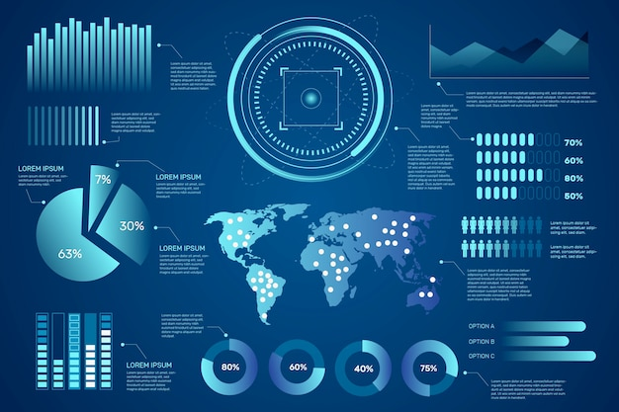
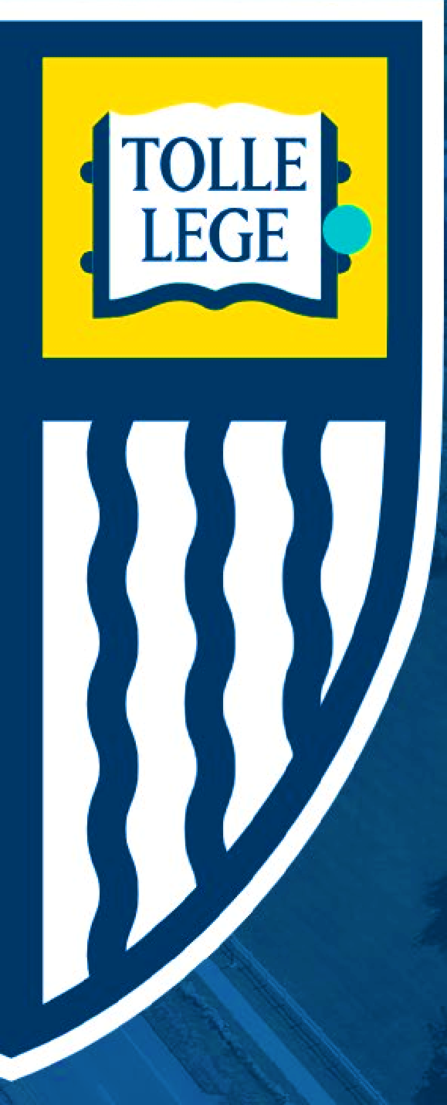

DSA5400
Visual Data Exploration
Module 8: Story Telling and Wrap-up
Michael Dupin, Ph.D.

Slide 2

Course Roadmap & Assignments
Week 1 | Week 2 | Week 3 | Week 4 | Week 5 | Week 6 | Week 7 | Week 8
Course learning objectives Data, information, and knowledge Intro to data visualization | Data as a competitive advantage CRISP framework Human perception and cognition | Data types Intro to ML Foundations Grammar of graphics Advanced Visualizing segments | EDA process and due diligence Foundations ggplot2 Advanced Sharing plots | Diagnosis and treatments Special cases: time, space, and clusters | Segmentation R Shiny | More qualitative Segmentations Segmenting in R Flexdashboard | Story Telling Course wrap-up
Introduction | Position Paper #1 | Position Paper #2 | Data Due Diligence Project |  | Segmentation and Profiling Project
Quiz 01 | Quiz 02 | Quiz 03 | Quiz 04 | Quiz 05 | Quiz 06 | Quiz 07 | Quiz 08

Slide 3


Last Quiz
“You are working for a political or non-profit organization which depends on contributions and volunteers to be productive. Choose a segmentation approach (value, RFM, demographics, etc.) and describe how your organization could utilize the segments you might identify.”
Segmentation – let’s choose RFM
Recency (R): Measures how recently a donor has made a contribution or a volunteer has offered their time. This dimension helps in identifying those who are currently active versus those who may need re-engagement strategies.
Frequency (F): Assesses how often an individual contributes or volunteers over a given period. High-frequency donors or volunteers are typically more engaged and potentially more loyal to the organization's cause.
Monetary value (M): Gauges the total financial contribution from donors or could be adapted to assess the value of a volunteer's time based on the duration or the criticality of their contribution.
Application of Segmentation
Prioritize Engagement: Identify high-value contributors and volunteers (high on all three RFM dimensions) and prioritize them for engagement.
Tailor Communications:
Recent donors can be thanked and informed about the direct impact of their donations
Those who haven’t donated recently might be re-engaged with updates on new initiatives or urgent funding needs.
Optimize Resource Allocation: Focus fundraising efforts or volunteer recruitment drives on the most engaged (high frequency) or the most generous (high monetary value)
Reactivation Strategies: Implement reactivation strategies such as reaching out with a special campaign that resonates with segments with low recency scores
Customize Volunteer Opportunities: Frequent volunteers might be given opportunities to take on leadership roles or engage in more skilled tasks, while newer or less frequent volunteers might be offered roles that require less commitment or training.
Monetary
Recency
Frequency

Slide 4
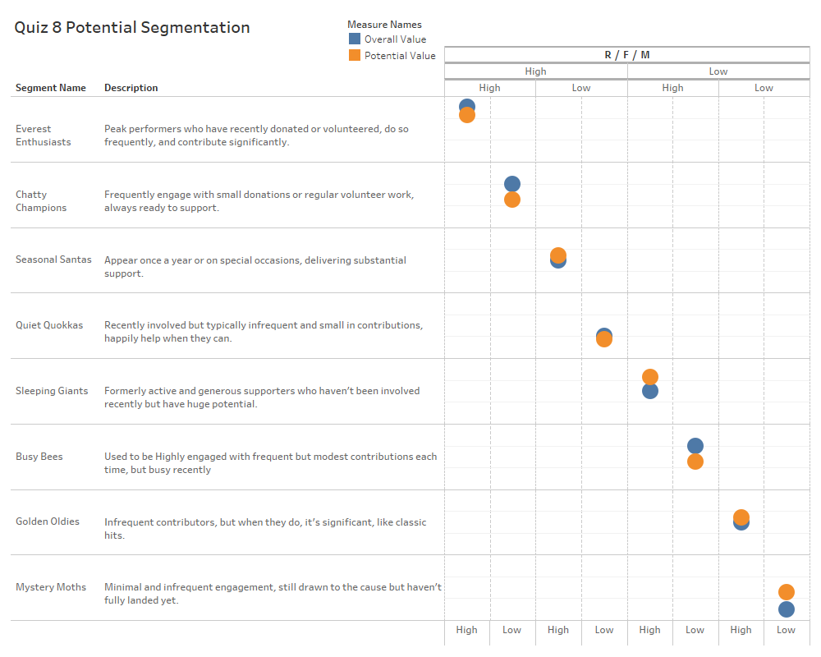
Last Quiz- An example that might help for the Final Project
{ Potential Value,
Overall Value }
Recency
Frequency
Monetary
Recency
Frequency
Potential Value to reflects the potential future value, considering factors like capacity for further engagement and growth
Overall Value is based on all recency, frequency, and monetary value.
Limited resources (story of any Company’s life)- can only invest in 3 segments. But which ones?
Everest Enthusiasts: Highest overall and potential value, investing in this group is essential. They are both highly engaged and have demonstrated significant contribution levels.
Sleeping Giants: Although their recent engagement is low, their historical frequency and monetary contributions are high, giving them a high potential value.
Golden Oldies: Despite their low recency and frequency, their high monetary contributions when they do engage suggest untapped potential.
Monetary
If more resources became available to invest in another segment, the next choice would be:
Mystery Moths: They have the lowest current engagement but a high potential value. This segment represents a growth opportunity!

Slide 5

Segmentation (final) Project
Do
Use formatting (bold, bullets, sections/subsections)
Number your pages, label and number your figures/tables
Use log scales where appropriate (log linear or log-log)
Justify your choices
Tell a story, comment on your findings (the “what does it mean” and not just the “what”)
When an ask is to create 10 things, list them explicitly (to ease the reviewer’s work)
Follow the layout suggested in the instructions
Use raster format for your images
Make sure to address every item in the instructions
Don’t
Use “I”. Prefer the passive form
Overcrowd your graphs
Use pixelized graphs
Have spelling mistakes, grammatical issues, etc

Slide 6
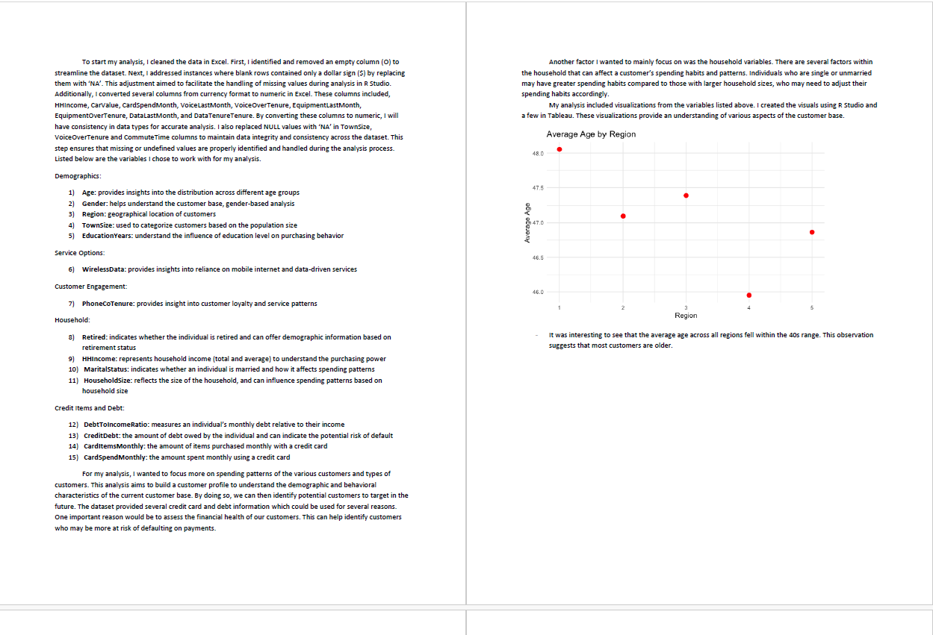
Example 1: Has Some Things To Improve

Slide 7
Example 2: Better

Slide 8
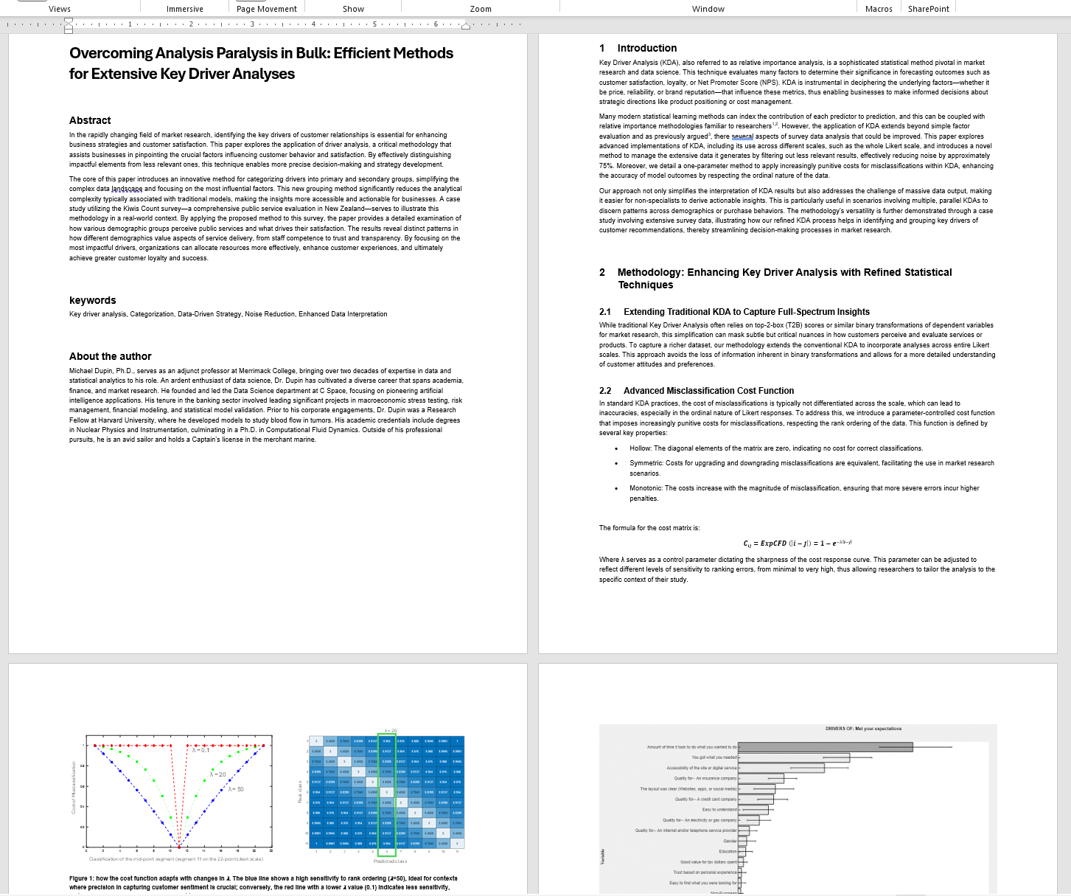
Example 3: Draft of an Academic Paper

Slide 9
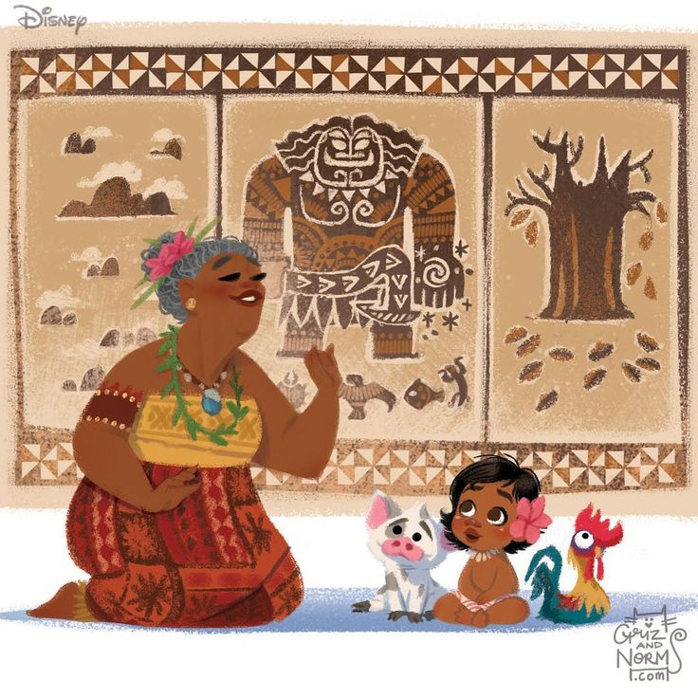
Segmentation Assignment Storytelling
How to tell a good story

Slide 10
Goals of a good data story – 3 E’s
Engage
Talk in the audience’s language about things that interest them.
Present the story in engaging mediums
Explain
Why are the statistics and analysis of what you are presenting important?
Why did you make the decisions that you did in your analytical journey?
Enlighten
What did we learn?
What does it mean for goals of the business?

Slide 11
Components of a Good Data Story
Graduating into Professional Environment:
Component | High School Paper | Professional Data Story
Background | General historical, social context | Specific business environment and market conditions
Motivation | Personal interest, relevance to current events | Specific business objectives and goals
Journey | Research process, experiments, literature review | Detailed data analysis and visualization
Resolution | Summary of findings, speculative implications | Definitive outcomes related to business goals
Sequel | Future research possibilities, open-ended | Specific, actionable business recommendations

Slide 12
Components of a Good Data Story
Data should be distilled to only the most relevant components
Background vs. Business Context
High School Paper: The background provides general information about the topic, often exploring historical, social, or scientific aspects. It sets the stage for the reader, establishing the relevance of the topic. For example, a paper on climate change might describe past climate trends and their impacts on ecosystems.
Data Story: The business context serves a similar foundational role but is tailored to the specific needs of a business or organization. It details the operating environment, market conditions, or customer demographics that are relevant to the analysis. For instance, a data story about customer churn might start with an overview of the company's customer base and market conditions that affect retention.
Motivation vs. Business Goals
High School Paper: Motivation might explain why the topic was chosen, its relevance to current events, or personal interest. For example, a student might write about renewable energy because of a rising interest in sustainability driven by global climate change.
Data Story: Business goals are more targeted, focusing on specific objectives the business aims to achieve through the data analysis. For instance, the goal might be to increase sales by 10% through improved customer segmentation and targeted marketing strategies.
Journey vs. Analyses
High School Paper: The journey documents the research process, discussing the exploration of various sources, experiments conducted, or different perspectives considered. It might involve a detailed description of a science experiment or a summary of literature on a given topic.
Data Story: Analyses translate the business context and goals into actionable insights. This involves using statistical models, data mining techniques, and visualization tools to explore data and identify patterns. For example, analyzing customer data to identify key factors that predict churn.
Resolution vs. Conclusions
High School Paper: The resolution sums up the findings and reflects on the implications of the research. It might conclude that further research is needed or suggest a potential solution to a problem.
Data Story: Conclusions in a data story are definitive statements that describe the outcomes of the analyses in the context of the business goals. For example, concluding that a particular customer segment has a high churn rate and identifying the main reasons behind it.
Sequel vs. Recommendations
High School Paper: The sequel might discuss future research possibilities or broader implications of the findings. It’s often speculative and open-ended, such as suggesting areas where more detailed study is needed.
Data Story: Recommendations are practical actions that the business can take based on the conclusions. These are typically specific, actionable, and aligned with business strategies. For example, recommending targeted customer retention strategies or adjustments to product offerings based on the data analysis.

Slide 13
Story Telling for the final Project - Answering 6 basic questions
What is the business objective and task?
What segments did we identify and how we arrived our final segmentation solutions? (provide justification)
What customer segments have the highest economic value?
What do high retention customer segments look like? How are they different from lower value segments?
Why we consider the segments to be high retention while others are low retention?
Leveraging segmentation solution and segment profile insights:
What segments should we target for retention effort?
What is our value proposition for the target segments? (why a customer should choose your product or service)
Explain
Enlighten

Slide 14
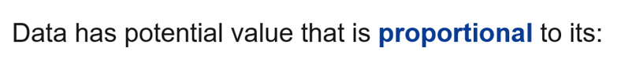
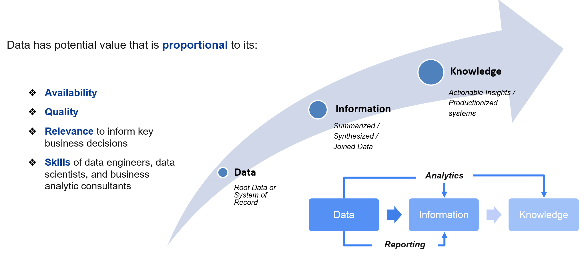
Full Circle – 1/2
Final Project
Data Due Diligence

Slide 15
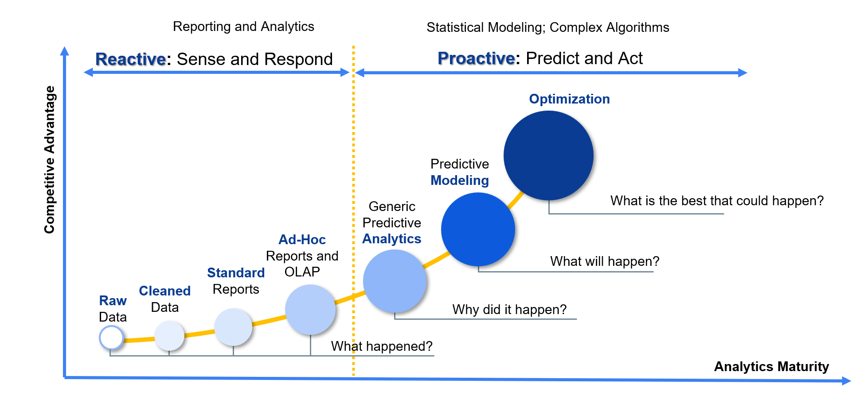
Full Circle– 2/2
Final Project
Data Due Diligence

Slide 16
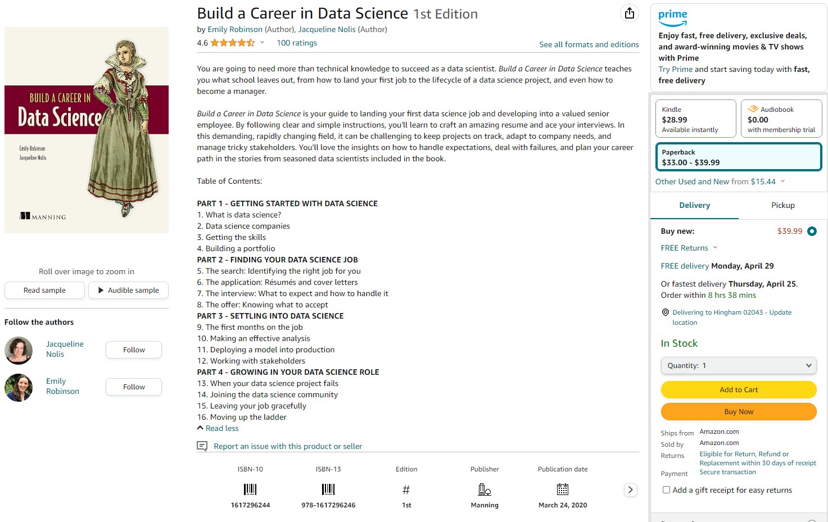
A suggested book as you carry on
Building a Career in Data Science by E. Robinson and J. Nolis
https://podcast.bestbook.cool/
Or directly from the publisher ($22) : https://www.manning.com/books/build-your-career-in-data-science?a_aid=buildcareer&a_bid=76784b6a

Slide 17
Open Q&A
Now it’s your turn

